Slide 1
Application Software
Spreadsheets
"Number crunching"

Slide 2
Spreadsheet Concepts
Spreadsheet—a document containing values and other data organized into rows and columns; created with spreadsheet software.

Slide 3
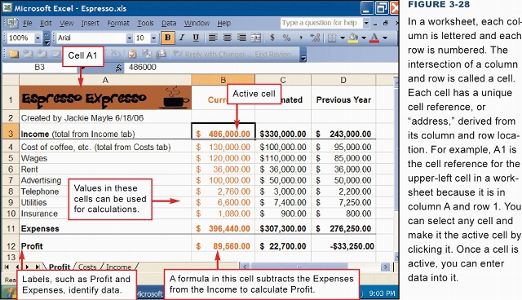
Spreadsheet Software
A spreadsheet uses rows and columns of numbers to create a model or representation of a real solution
Spreadsheet software, such as Microsoft Excel, provides tools for creating worksheets

Slide 4

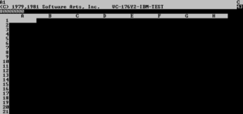
Spreadsheet Origins
Visicalc – first spreadsheet program for microcomputers
  Written by Dan Bricklin and Bob Frankston in 1978-1979
  Written for Apple II PCs
  a "killer app" for microcomputers
Dan Bricklin
Visicalc

Slide 5
Spreadsheet Uses
What problems are suitable for spreadsheets?
  Moderate amount of data that will be reused
  Need for formatting, graphing, analysis
  Not large amounts of text - Word processing is better
  Not large amounts of data or complex queries - Database Manager is better

Slide 6
Using Spreadsheets Across Disciplines
Used for business applications, such as accounting
Used for “what-if” analysis in business planning
Can also be used in scientific applications
  Geologists can use to chart data about scientific phenomena
  Social Scientists can use to predict voting results
Notes:
An example of a “what-if” analysis might be sales projections. If you project sales to be 5% higher next month, you can project sales for next month. Then, you can compare the projection with the actual sales figure for that month.

Slide 7
Proofread and verify your data!
Spreadsheets are dumb!
They don’t know when a number doesn’t make sense. You do.
GIGO – garbage in, garbage out
Double check your results before trusting them

Slide 8
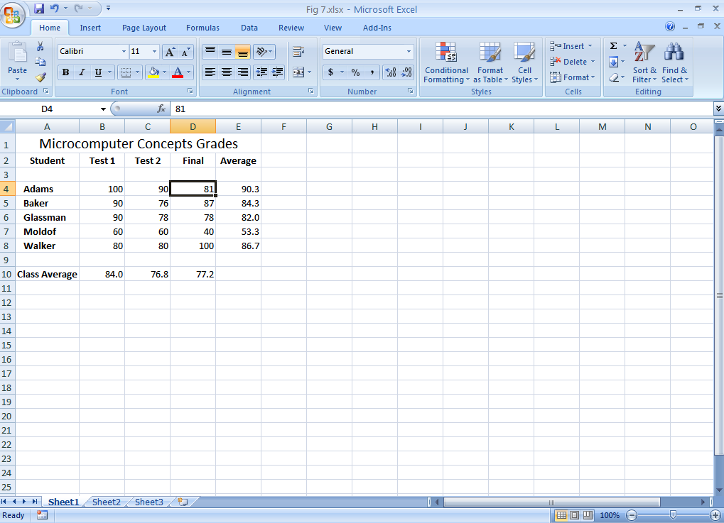
Identifying Excel Window
Components
Formula Bar
Name Box
Select All button
Active Cell
Sheet Tabs
Status Bar
Notes:
The currently Active cell in this figure is D4. This is indicated by heavy border around it.
The Name Box displays the name of the currently Active cell.
The Formula bar displays the contents of active cell D4.
The sheet that is currently displayed is Sheet1. There are two other worksheets─Sheet2, Sheet 3─ available in the workbook.

Slide 9
Creating and Editing a Worksheet
Data is entered into cells where rows and columns intersect.
  Rows are Numbered, Columns Assigned Letters
Cells identified by their cell address, such as A1 or E5.
Can refer to or select a range of cells
  (A1:E1) – range in a row
  (A1:A10) – range in a column
  (A1:E10) – range in a rectangle

Slide 10
Ranges
A range is a rectangular group of cells in a worksheet
  Can be one cell; may be entire worksheet
How to select a range
  Click and hold left mouse button and drag from beginning of range to end
  Select first cell, then hold the Shift key while clicking the last cell
Can be contiguous (together) or noncontiguous (not together) (Ctrl key)
Notes:
A contiguous range is single rectangular block of cells. A non-contiguous range consists of two or more separate non-adjacent ranges.
The cells within a range are specified by indicating the diagonally opposite corners, typically the upper-left and lower-right corners of the rectangle. For example, B4:I4. is a range of cells starting with cell B4 and ending with cell I4.

Slide 11
Edit Data in a Cell
Three common methods to edit data in a cell:
  Select the cell you want to edit, click in the Formula Bar, make changes, press Enter
  Double-click in the cell to be edited, make the changes, press Enter
  Select the cell, press the F2 key, make the changes, press Enter
Two options to clear the contents of the cell:
  Click on the cell and delete
  Click on Clear arrow in the Editing group on the Home tab
Notes:
Even though there are multiple ways to edit data in a cell, most users will select one method and stay with it.

Slide 12
Cell Contents
Cells can contain one of three things:
  Label – descriptive text (like name or Section)
  Constant Value – number typed in
  Formula – derived value calculated by the machine
    Formulas can contain values, arithmetic symbols, parenthesis, functions, and cell references
    Click here to play

Slide 13
Formulas
A formula tells the computer to do some calculations
Most formulas use the values in one or more cells to do the calculations
A formula uses a cell reference to tell the formula what cells to use in the calculation instead of the actual values (numbers)
  =(B5+5) instead of =(23+5)

Slide 14
Formulas
Start with = or +
Uses algebraic hierarchy of operations
  Parenthesis, then functions, then * and /, lastly + and –
Evaluated by the computer and the answer displayed in the appropriate cell
  Automatic Recalculation
Many Built-In Functions Available
  Date/Time, Finances, Math, Stats, Logical, etc…

Slide 15
“Math” words
“difference” = subtraction
“product” = multiplication
“sum” = addition
“quotient” = division
If you are trying to figure out a formula for a problem, look for those words – they’ll tell you which operator or function to use

Slide 16
Example Formulas
=SUM(A2:A7)
=B4 / C5
=(7 - B3) * A1 + 1
=Average(b4:b9, c9:c12)
=0.5 * B3
=3.14159*r4*r4

Slide 17
Using AutoSum (Σ)
Automates the SUM function
Click the cell where you want the result
Click AutoSum button
Select the range of cells you want to sum
Press Enter to complete
=Sum(C4:C10) represents sum of all the cells in the cell range C4 to C10
MISTAKE: =sum(a4+b4+c4)
MISTAKE: =sum(a4,c4) when you mean =sum(a4:c4)

Slide 18
Basic Statistical Functions
Perform a variety of calculations to aid in decision making process
  AVERAGE calculates the average of a range of numbers
  MIN calculates the minimum value in a range
  MAX calculates the maximum value in a range
  COUNT counts the number of values within a range
  MEDIAN finds the midpoint value in a range
Notes:
The basic statistical functions include the following:
AVERAGE calculates the average of a range of numbers.
MIN calculates the minimum value in a range.
MAX calculates the maximum value in a range.
COUNT counts the number of values within a range.
MEDIAN finds the midpoint value in a range.
COUNTA function counts the number of cells in a range that are not blank.

Slide 19
Date Functions
Efficiently handle time-based calculations
Help analyze data related to the passing of time
TODAY() function places the current date in the selected cell
  Updates when file is opened again
NOW() function displays current date and time, side by side
Notes:
The NOW function also updates automatically. The Function AutoComplete will provide a drop-down list of known options from which to select.

Slide 20
Auto Fill
Enables you to copy the content of a cell or a range of cells
Drag the fill handle over an adjacent cell or range of cells
  The fill handle is a small black square appearing in the bottom-right corner of a cell
Use to copy contents of one cell many times
Use to complete a sequence like years or months
Notes:
The user clicks on the cell and uses the fill handle to repeat the content.

Slide 21
Relative vs. Absolute Addressing
Relative cell references change relative to the direction in which the formula is copied
Absolute cell references are exact; they do not change when a formula is copied
  Indicated by dollar ($) signs in front of the column letter and row number
  Most often used when the value need not change, such as a sales tax rate.
Use the F4 key to toggle between relative and absolute and mixed cell referencing
Notes:
When you copy a formula containing a relative cell reference over multiple columns, the column letter changes. When you copy a formula containing relative cell reference down multiple rows, the row number changes.
Mixed cell reference is a formula that contains both relative and absolute cell references. Remember, formulas should always be based on cell references.

Slide 22
Copying Formulas
What Happens if you copy a formula to a different cell?
Relative Cell Reference → No $ Used
  =(B7 / 3.0)
  Cell reference is CHANGED in new location
Absolute Cell Reference → Uses one or more $
  =($B$7 / 3.0)
  Cell reference is NOT changed in new location

Slide 23
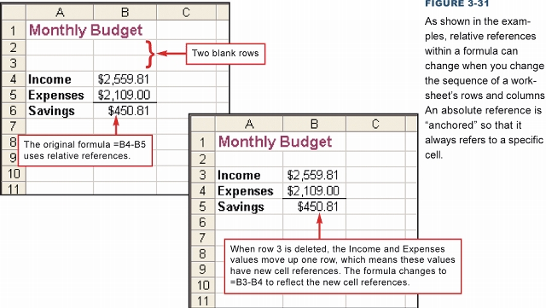
Copying Formulas
Relative references
within a formula will
CHANGE when copied to another location. An absolute reference is “anchored” so that it always refers to a specific cell.
CLICK TO START VIDEO

Slide 24
Printing A Worksheet
Standard Options (portrait, landscape, size, etc…)
With or Without Formulas Shown
Custom Printing Areas
Always use Print Preview with Spreadsheets, to save paper

Slide 25
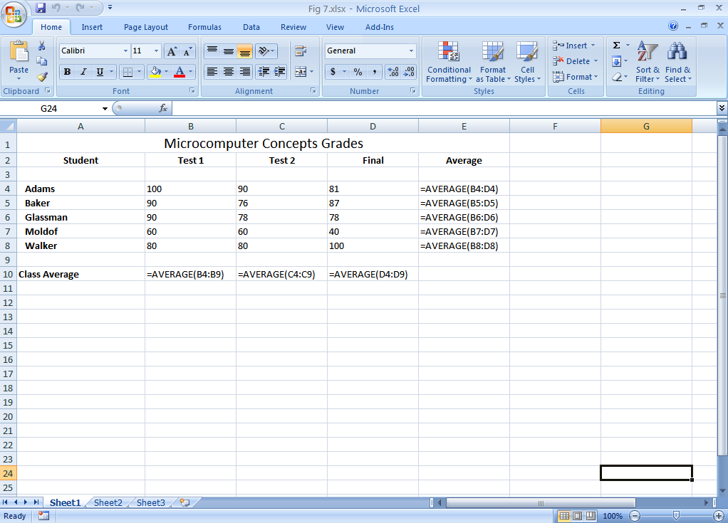
Displaying Cell Formulas
Press the Ctrl key plus the tilde (~) key to display formulas in a worksheet
Notes:
The tilde (~) key is created by holding down the Shift key while pressing the button to the left of the number 1 on the keyboard.
To toggle back to displaying values, simply press the Ctrl key followed the tilde key again.

Slide 26
Freezing Rows and Columns
Freezing is the process of keeping headings on the screen at all times
Allows you to work more easily with large worksheets
You can freeze both rows and columns or just the top row or the first column
Notes:
26
To freeze columns and rows:
1. Select the cell below the row(s) and to the right of the column(s) you want to freeze.
2. Click the View tab and click Freeze Panes in the Window group. You can freeze both rows and columns or just the top row or the first column.
You can also unfreeze the rows and/or columns

Slide 27
Spreadsheet Error Messages
DO NOT Ignore these!
!DIV0 – Divide by Zero
  Check and repair formula
Cell full of #'s - Cell is too narrow for contents - solve by widening the column
#NUM – Invalid argument value for function, like SQRT(-1) - solve by fixing the argument
#NAME - invalid name for function
Circular References

Slide 28
Sorting Data
Make sure you select ALL the data that is to be sorted, not just the column that provides the order
Data menu then Sort
Header row = first row in selection used as labels and not moved when the sorting happens
Ascending = A-Z, Descending = Z - A

