Slide 1
Application Software
Advanced Spreadsheets
"Number crunching"

Slide 2
Logical IF Function
IF function has 3 parts
  Condition
  Value if Condition is TRUE
  Value if Condition is FALSE
Examples
  =IF( A4>0 , “Yes” , “No” )
  =IF (C5 < D9, 15*B4, 10*B4)

Slide 3
Insert/Delete Rows or Columns
Due to modifications required in a worksheet, rows and columns may need to be inserted
To insert a new row
  Click on the row number below where you want the new row inserted
To insert a new column
  Click on the column letter to the right of where you want the new column inserted
Be careful with your formulas - if they refer to a cell in the range that was changed, they will be changed too!
Notes:
If the active cell is E4, then row 4 is the current row. If a row is added, it is inserted above. If a column is inserted, it is inserted to the left of E4.
The process is similar for deleting rows and columns except you begin by choosing the Delete pull down arrow in the Cells group. The row above the row selected is deleted or the column to the left of the selected column is deleted.

Slide 4
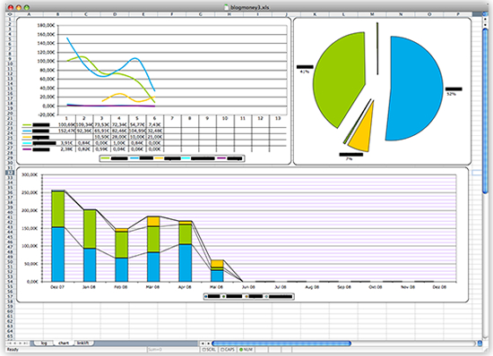
Charts
A chart is a graphic or visual representation of data
Multiple chart types can enhance information, adding visual appeal and making it easy to analyze data
Notes:
4
A chart is a graphical representation of data. Excel offers multiple options to present the data in a visual form that is appealing and easy to evaluate.

Slide 5
Choosing a Chart Type
Graphic representation of data
Attractive, clear way to convey information
Select the type of chart that best presents your message
Add enhancements to better communicate your information
Notes:
5
Graphic illustrations of data make it much easier to present the information.
A variety of chart options are available that can be modified to better communicate your ideas.

Slide 6
Column Charts
Used to show actual numbers rather than percentages
Displays data comparisons vertically in columns
The X or horizontal axis depicts categorical labels
The Y or vertical axis depicts numerical values
The plot area contains graphical representation of values in data series
The chart area contains entire chart and all of its elements
Notes:
6
A column chart is the most effective choice when you are limited to a small number of categories, generally seven or fewer.
A column chart is used when there is need to show actual numbers rather than percentages.

Slide 7
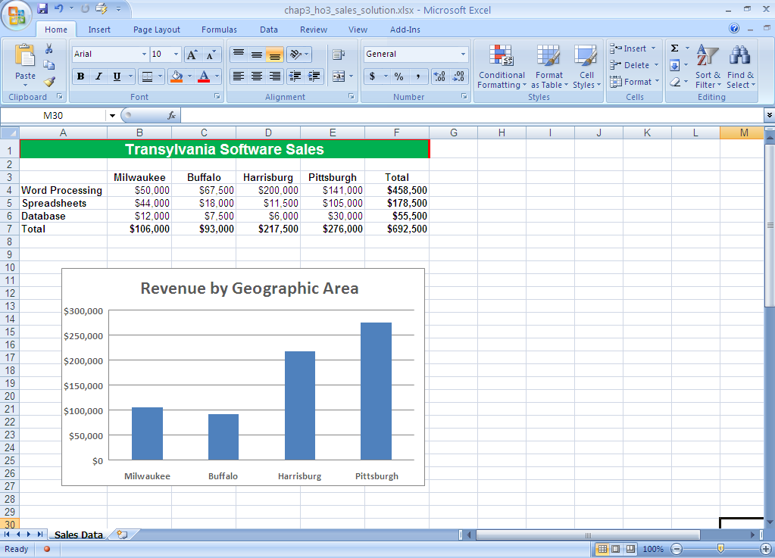
Column Charts
Column chart displays the revenue of software sales by city
  The height of the column reflects revenue of each city
  Pittsburgh has the highest revenue and Buffalo has the lowest revenue
Notes:
7
Column charts use vertical bars to represent data.
This column chart displays the revenue of software sales by city. The height of the column reflects revenue of each city. Pittsburgh has the highest revenue and Buffalo has the lowest revenue.

Slide 8
Creating a Chart
Six main steps to create a chart
  Specify the data series
  Select the range of cells to chart
  Select the chart type
  Insert the chart and designate the chart location
  Choose chart options/add graphics in charts
  Change the chart location and size
Notes:
8
There are six main steps to creating a chart:
Specify the data series.
Select the range of cells to chart.
Select the chart type.
Insert the chart and designate the chart location.
Choose chart options/add graphics in charts.
Change the chart location and size.

Slide 9
Six Steps
Specify the data series
  The rows and/or columns that contain the data you want to chart
Select the range to chart
  Can be a single cell, but most often is multiple cells
  Cells may be adjacent or non-adjacent
  Use Shift key to select adjacent cells; use Ctrl key to select non-adjacent cells
Notes:
9
The most common mistake users make is that they don't think about the data they want to plot and how they want it to be represented.

Slide 10
Six Steps (continued)
Select the chart type
  Each type presents data in a different way
  Pick the type that will best visually illustrate the information you want to convey
Notes:
10
The type of chart you choose will determine how well the information will be conveyed.

Slide 11
Select a Chart Type
Chart Type | Purpose
Column | Compares categories, shows changes over time
Bar | Shows comparison between independent variables. Not used for time or dates
Pie | Shows percentages of a whole. Exploded pie emphasizes a popular category
Line | Shows change in a series over categories or time
Doughnut | Compares how two or more series contribute to the whole
Scatter | Shows correlation between two sets of values
Stock | Shows high low stock prices
Notes:
11
Each chart type is used to display different types of data in a variety of ways. Select the one that best suits your needs.

Slide 12
Six Steps (continued)
Insert chart and designate location
  Insert as an embedded object in the worksheet
    Can print worksheet and chart on one page
  Insert the chart as a New Sheet
    Will require you to print the worksheet and chart on separate pages
  You can choose the location to display the chart
Notes:
12
You can insert a chart as an embedded object in an Excel worksheet.
You can insert a chart as a new sheet in an Excel workbook.

Slide 13
Six Steps (continued)
Choose chart options using the Design, Layout and Format tabs
  The Design tab can be used to display data in rows or columns
  The Layout tab can be used to change the display of chart elements
  The Format tab can be used to apply special effects
Notes:
13
The Design tab is used to display the data series by row or by column, make changes to the source data of the chart, change the location of the chart, change the chart type, save a chart as a template, or select predefined layout and formatting options.
Layout is used to change the display of chart elements such as chart titles and data labels, use drawing tools, or add text boxes and pictures to the chart.
Format is used to add/fill colors, change the line styles, or apply special effects.

Slide 14
Six Steps (continued)
To change the chart location and size
  Select the chart to reveal sizing handles
  Drag the sizing handles to achieve desired location and size
Notes:
14
Click and drag the middle left or right sizing handle of the edge borders to adjust the width of the chart. Drag the sizing handle away from the chart to stretch or widen the chart; drag the sizing handle within the chart to decrease the width of the chart.
Click and drag the top or bottom middle sizing handle to adjust the height of the chart. Drag the sizing handle away from the chart to increase its height; drag the sizing handle in the chart to decrease its height.
Click and drag a corner sizing handle to increase or decrease the height and width of the chart proportionately.

Slide 15
Print Charts
You can print a chart:
  Including the worksheet in which it is embedded
  That is embedded, without printing the worksheet
  That was placed on a separate worksheet
Always Print Preview to ensure you are printing what you intended
Select Print from the File menu or click the Print button on the Standard Toolbar

Slide 16
Macros
You Can Record a Series of Commands and/or Keystrokes to be Replayed Later
This Recording is Called a Macro
DANGER: Some viruses and spyware create malicious macros in Word, Excel, Outlook, etc…
  Macro-Virus

Slide 17
Macros - How to
A recording of actions that can be saved and played back
Go to Developer / Record Macro (or View / Macros / Record Macro)
Give it a name (and a shortcut if desired)
Now it is recording, so perform your actions - typing, clicking, dragging, etc.
Click on Developer / Macros / Stop Recording (or View / Macros / Stop Recording, or click on small button on bottom of screen)

Slide 18
Macros – How to (cont’d.)
To play back a macro, Developer / Macros (or View / Macros / View Macros) and click on the macro name then Run or use shortcut
When you play back or record, be aware of where your cursor is before you start the macro – it can make a difference!

Slide 19
How to show the Developer tab
Developer tab is not on Ribbon by default
To show it if it isn’t visible:
Click the File tab.
Under Help, click Options.
Click Customize Ribbon.
Under Customize the Ribbon, select the Developer check box.
The setting should persist – you shouldn’t have to do it more than once

Slide 20
Saving a file in Excel 2010 with Macros
You have to save the file as a different file type (extension)
Only file extensions that end with m in 2010 will have macros (docm, pptm, xlsm)
Choose Save As and choose the type xlsm

Slide 21
Opening an xlsm file in Excel 2007
You may get a warning when you open an xlsm file that says “all macros are disabled”
If so you need to set the security level of the file
Get the Developer tab on the Ribbon if you don’t have it
Choose Macro Security and Enable all macros (be careful about this! Know your macros!)
Then open the file again

Slide 22
Opening an xlsm file in Excel 2010
You may get a warning bar when you open an xlsm file that says “all macros are disabled”
It will have a button that says “Enable Content”
Click on that and you will have your macros
Only do this if you KNOW where the macros came from!!

Slide 23
Relative references in a macro
By default, a macro is recorded with the actual cell locations that you used when you recorded it, and only works on THAT location
If you turn on “Use Relative References” it will work ANYWHERE on the sheet, based on where your cursor is when you start the macro running
You can tell if the setting is on by looking at the icon on the Macro menu choice

