Slide 1
Database Objects
And some miscellaneous topics
Concurrent access and sorting

Slide 2
Objects
Tables
Queries
Reports
Forms
Macros
Modules
Objects
2
Notes:
2
The elements of a database are referred to as objects. Access utilizes six different types of objects: tables, queries, reports, forms, modules, and macros. Of these six objects types, the only mandatory object is one table. All other objects may or may not be included in the database per the database users needs. Objects are located in the Navigation pane of the Access window.

Slide 3
Reports
Reports are created when a more formal printout is desired.
Use a wizard to create a report
Executes one or more queries and presents the results in a more organized fashion
Can sort the data, can do simple arithmetic (totals)

Slide 4
Queries
Asking questions about the data in the database
Two different query interfaces (SQL and QBE)
See separate slides for details (Database Queries)

Slide 5
Forms
Allows you to customize the interface for entering data
See separate set of slides for that topic

Slide 6
Sorting Records
Can sort records in a database by field values
Single Field Sort
Sort all students in the DB by home state
Multi-Field Sort (Field A within Field B)
Sort all students in the DB by home state then by alphabetical order of last name (Name within State) State is primary sort field, Name is secondary sort field
Access sorts multiple fields left to right

Slide 7
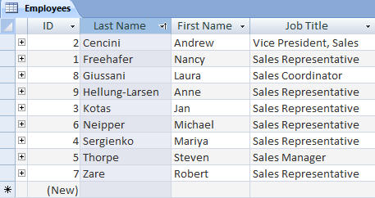
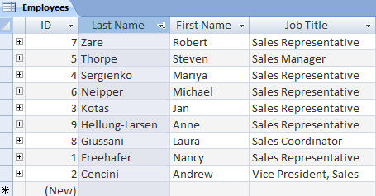
Sorting Table Data
Last Name field sorted ascending
Last Name field sorted descending
Lists records in ascending or descending order according to one or more fields
7
Notes:
7
The Sort feature in Access, just like the other Office applications, allows you to lists records in ascending or descending order according to one or more fields.

Slide 8
Concurrent Processing
Large databases allow more than one person to access a file at one time
Have to be careful to control access - can lose data that way
the user who writes LAST is the change that “sticks”

Slide 9
Concurrent Processing (cont’d)
MS Access uses a lock file to control this
.laccdb file created when an .accdb file is opened, says that it is "locked" so no one else can use it
lock file goes away when database file is closed
DO NOT submit it INSTEAD of your database file!

Slide 10
Access or Excel?
Use Excel when:
Use Access when:
Your data is of a manageable data size
There is no need for relationships between data
You are primarily creating calculations and statistics
You are working with large amounts of data
You need to create relationships between your data
10
Notes:
10
Use Excel when:
1. Your data is of a manageable data size
2. There is no need for relationships between data
3. You are primarily creating calculations and statistics
Use Access when:
1. You are working with large amounts of data
2. You need to create relationships between your data
3. You rely on external databases to analyze data

Slide 11
Understand Large Database Differences
Most large companies separate their database into front and back ends
Front end – contains the objects needed to interact with data, but not the tables where the record values reside
Back end – contains the tables where the data resides
Makes it easier to control security, to hire specialists in both areas, to change vendors of software if needed
Notes:
11
To ensure data integrity, to maintain security and to avoid mishaps, most large companies separate their database into front and back ends.
Front end – contains the objects needed to interact with data, but not the tables where the record values reside.
Back end – contains the tables where the data resides

