Slide 1
Creating a table in Access

Slide 2
Table Design Considerations
Just as you first create a blueprint to build a house, you should first sketch or outline the design of a database table
Careful pre-planning
will save you much time
in the future
Notes:
2
Just as you first create a blueprint to build a house, you should first sketch or outline your table design. (Add: Careful pre-planning saves you much time in the future. There are many factors that affect both the design and structure of a database.

Slide 3
Tables in a Database
Each Field in the table has…
  name
  data type
  field width
After the table structure is complete, data can be entered into the table’s fields.
  default values
  required?
  primary key?

Slide 4
Data Types for the Fields
Text
  alphanumeric, alpha, string – holds any character
Numeric
  byte, short, long, integer
  Single, double, currency (decimal points, $)
Date
Memo
Logical (binary or Boolean or yes/no) (check box)
Hyperlink
Object

Slide 5
Data Validation
Make sure the data in the computer matches the real-world information it represents
  Data Type Enforcement
  Default Values
  Ranges
  Required Fields
  Unique Keys
  Non-Null Keys

Slide 6
Data Validation
Make a field numeric types ONLY when you plan to do arithmetic with the field and it makes sense to do it!
Social security numbers, for example, should be TEXT not Long integers – you do not want someone to total them by accident, it would be meaningless

Slide 7
Table Design Considerations - PNPI
Short for Personal, Non-Public, Information
PNPI laws govern the safeguarding of data such as:
  social security numbers
  credit card numbers
  Educational records (FERPA – Family Educational Rights and Privacy Act of 1974)
  bank account numbers
  medical records (HIPPA – Health Insurance Portability and Accountability Act of 1996)
Notes:
7
Short for personal, non-public, information, PNPI laws govern the safeguarding of data such as social security numbers, credit card numbers, bank account numbers and medical records.

Slide 8

Table Design Considerations – Store Data in its Smallest part
Like this
Not like this
For greater flexibility, store data in its smallest part
  Instead of one field for an address, use many
  Instead of one field for a name, two or three
Notes:
8
For greater flexibility, store data in its smallest part. It is much more difficult to search for data when more than one piece of information is in one field. Examples include: instead of one field for a persons address, break the address into three fields – street address, city, state and zip. Instead of one field for a persons name, break the name into two or three fields – first, last and possibly middle initial.

Slide 9
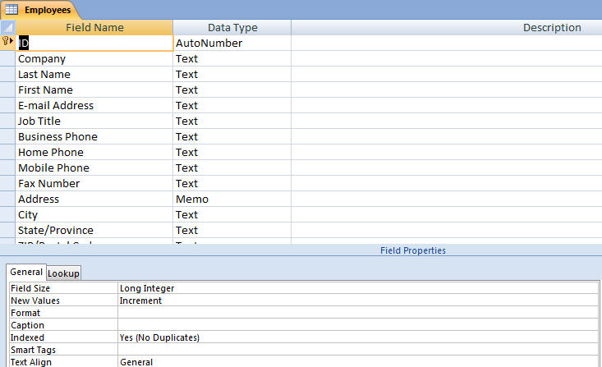
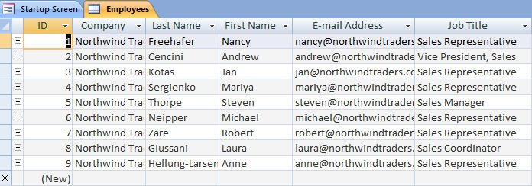
Work with Table Views
Design View
Datasheet View
Datasheet (Table) View – used to add, modify, delete and view records
Design View – used to create and modify the fields in a table
9
Notes:
9
When working with tables, two different table views exist. Datasheet View is used to add, modify, view, and delete records. You may also choose to enter field names in this view when you are first creating your table. The other view, Design View, does not allow record entry. It is used for entering field names and specifying properties of the fields, such as the size of the field. You may also edit existing fields, including those that were first created in Datasheet View.

Slide 10
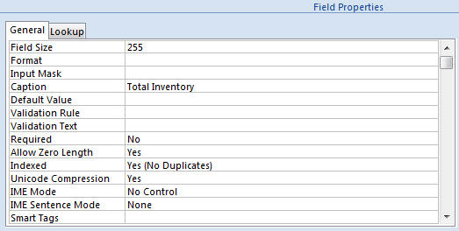
Work with Properties
Field Size property
Caption property
Field Properties can be used to specify characteristics for individual fields
Located in the lower pane of Table Design View
Notes:
10
Field Properties can be used to specify characteristics for individual fields. Field Properties can be found in the lower pane of the Table Design View.

Slide 11
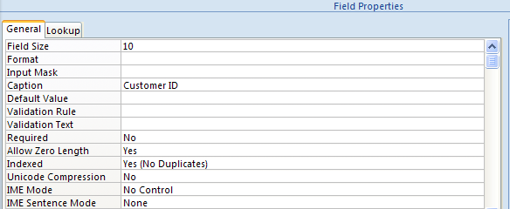
Table Design Considerations – Field Size Property
Set field size in the Field Properties
grid of Table Design View
Set the field size in Table Design View
Always anticipate the current field size, may one day need to be larger
Notes:
11

Slide 12
How To
If database is completely new, the table creation process will start automatically when you open the database
Otherwise you use Create / Table on Ribbon

Slide 13
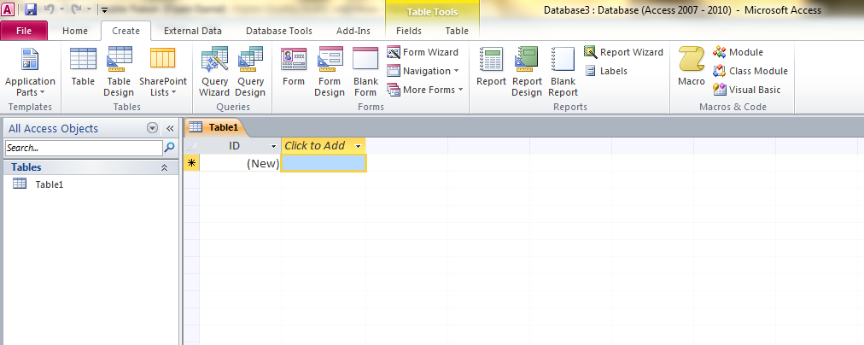

Slide 14
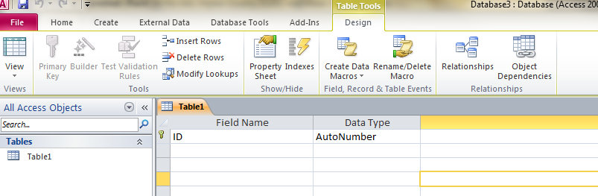
Change to Design View
Click on Home
Click on the Design View menu choice - far left end of the Ribbon with grid box on it

Slide 15
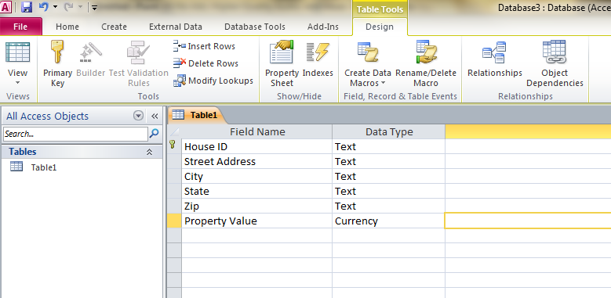
Enter field names and types

Slide 16
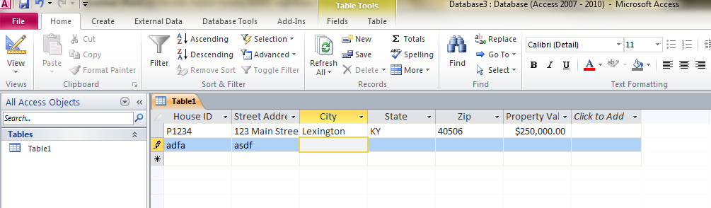
Enter data in fields
Click on the Design view button to change to Datasheet view
Begin entering data, hitting Enter or tab after each field

