Slide 1
Hardware

Slide 2
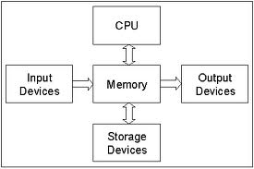
Basic Hardware
Hardware vs. Software
Hardware includes
CPU = central processing unit
Memory = RAM (random access memory)
Input = Keyboard, mouse, microphone
Output = Screen, speaker, printer
Storage = Hard drive, DVD, Solid State
Volatile vs. non-volatile
Memory and the CPU are volatile – they lose their contents when the power cuts off
Storage is NON-volatile – they maintain their contents until you erase them

Slide 3
CPU (Central Processing Unit)
Runs program (software) instructions
“Traffic cop” for rest of computer
RAM
Holds data and program instructios while being processed
Input devices
Keyboard, mouse, microphone
Output devices
Monitor (screen), speakers

Slide 4
CPU (System) clock
Device that puts out a regular signal is a clock to an engineer
Computer components operate at wildly different speeds
CPU, RAM at electronic speeds (nanoseconds)
Storage (HD, CD) at mechanical speeds (milliseconds)
Keyboard, mouse at human speeds (seconds)
They all need a signal to keep themselves synchronized
Like a conductor for an orchestra
An electronic device in the computer puts out a signal to all components millions or billions of times a second

Slide 5
CPU (System) clock
Units for measuring clock speeds = 1 Hertz = 1 signal per second
First PCs ran at 1.2 MHz (1.2 million signals per second)
Modern systems run at GHz (billion signals per second)
Typical laptop 1-2 GHz
Typical desktop 2-2.5 GHz
Gaming machine 3-4 GHz
This speed is one factor in how fact your computer can process instructions and data
Other factors – how much RAM, cooling devices, speed of graphics display, speed of Internet connection

Slide 6
CPU (System) clock
The chip manufacturer rates a chip for a certain clock speed
Some people push chips faster = Overclocking
Be careful, can void your warranty and shorten the lifespan of the computer
The faster, the hotter the machine runs!
Most desktop computers use some kind of fan to air-cool the CPU
Some push so fast they need a water-cooling system
Don’t smother your computer! Let the air flow through the slots on the case
Keep its environment dust-free if possible!
Blow out the dust with compressed air once in a while
Do not lay your laptop on a pillow, carpet or soft blanket
You can buy a “laptop cooler” fits under the laptop, has fans

Slide 7
RAM, cache memory
RAM (random access memory) is volatile – loses contents when power is cut off
One of most expensive components in a computer
Is the workspace for keeping the program instructions and the data being processed
Accessing memory locations is a lot faster than using storage devices
The OS loads a program completely into RAM first if possible before running it, or just a piece of it if that’s all that will fit
Having more RAM will let your computer run programs faster

Slide 8
RAM, cache memory
Cache is a piece of extra-fast, more costly RAM in or near the CPU
Data that is used repeatedly in short period of time kept there for quicker access
The OS can anticipate which data/instructions will be needed next and put them in cache so they can be gotten to quickly by CPU
Instead of making many trips to HD to get a small amount of data, get a larger amount which will be stored in RAM/cache until needed
If OS guesses incorrectly about what is needed next, it is a “miss”. If it is right, it’s a “hit”
Like making one trip to the store and bring back all the items you want and put in the pantry until needed, versus making many trips to the store for individual items

Slide 9
CPUs
Ways to compare CPUs
Clock speed - 1 GHz vs. 2 GHz = big difference, 2 GHz vs. 2.2 GHz – not so much
Cache memory
Level 1 (L1) nearest the CPU, usually on the same chip as the CPU
Level 2 (L2)
Level 3 (L3) farthest from CPU, shared between several CPUs
typical capacity 10 MB, 16 MB – more is a waste, can’t predict that far ahead
Word size
32 bits or 64 bits – refers to the size of the numbers the CPU can handle at one time
Which is also the size of the registers in the CPU
64 bit CPU usually backwardly compatible, will run older, 32-bit software too
Other processors
GPU = graphics processing unit

Slide 10
RAM versus secondary storage
Devices that are NOT volatile
Hard disk drives – magnetic
Solid state drives – electronic
Optical drives - laser
Cheaper to store data/programs
1 Tb drive versus 16 Gb of RAM – both cost about $100 right now
Slower to access data/programs
A million times slower than RAM speeds
More RAM lets you have process more data, larger programs
More storage spaces lets you keep more videos, songs, programs long-term

Slide 11
Virtual Memory
System may not have enough RAM to hold all of a program’s instructions
Virtual memory uses HD space to simulate having more RAM in a system
Operating System swaps parts of the programs in from and out to the HD
It is a slower process than having actual RAM on your machine – the hard drive is slower to access than RAM, and the act of swapping takes time.
It makes it possible to run programs which can’t fit in your computer’s memory.
So adding more real RAM to a computer will speed up its processing, there is not so much swapping in and out.

Slide 12
Comparing SSD and Hard Drives
http://www.pcmag.com/article2/0,2817,2404258,00.asp
Lifespan of either device is probably not going to be the determining factor in the lifespan of the computer as a whole
People get new machines before their HD or SSD wears out
Some manufacturers producing hybrid devices – Hard drive for capacity and then a smaller SSD for a buffer to the HD
Cloud storage is going to make both of these less important to the computer – using other people’s computers via the Net

Slide 13
Other secondary storage devices
Older devices
Magnetic tape on reels
Punched paper cards
Optical drives written on with lasers
Floppy disks – small, portable, 1.5 Mbytes capacity
SD cards
Small plastic rectangles that have solid state circuitry on them
Cameras, other portable devices
Flash drives (memory sticks)
Solid state devices
Usually draw power from the port / device they are plugged into
Caution about static electricity on exposed connectors!

Slide 14
Input devices
Keyboard
Mouse
Touch pad
Touch screen
Voice (Microphone)
Scanner
VR (virtual reality) equipment

Slide 15
Keyboards
Standard layout = QWERTY
Other layouts available – customizable in most OS
Dvorak layout more efficient than QWERTY (see Wikipedia)
“Sticky keys” for people with muscle control problems
Available in Windows OS
Most keyboards use USB port these days to connect to computer

Slide 16
Mice
Mechanical mice used a steel ball that rolled on surface – sensors could tell which way and how much the ball rolled
Optical mice (most mice these days) uses simple camera, takes pictures thousand times a second, compares them to determine distance moved and direction
Needs light source to take the pictures – usually LED
Can work on most surfaces, not so good on reflective surfaces
Wired mice get power from computer, wireless must use batteries

Slide 17
Touchpads and touch screens
Touchpads are used on some laptops to replace a mouse
Touch screens are larger membranes on top of display
Depends on skin conducting electricity to detect movement or taps
Can also use a stylus with the same properties as skin
Should be kept clean! And not wet!

Slide 18
Speech / Voice
Needs a microphone
Useful for situations where your hands are busy with something else
Not as fast as typing, noisier
Requires software – speech recognition
Turns audio signal into text or commands - Not perfected yet
Siri or Alexa
Device does not have the power to do much speech recognition
They listen constantly for their ‘trigger word’
When they hear it, they send the audio signal to server machine over Net which can do more complicated analysis

Slide 19
Scanners
Converts content on paper to digital signals
Pictures and graphs work better than text
Produces jpg, png or pdf
Usually has different resolution settings
Number of samples taken = amount of detail captured
High resolution yields better images, takes more time and space (files)
Low resolution does not give as good results, but is faster and smaller

Slide 20
Output Devices
Displays
LCD (liquid crystal display) most common, cheap, light weight, low power
Plasma display – better resolution, more expensive, more power
Gas turned into plasma by electricity to make it glow
To display colors, use Red, Green, Blue to mix together
Pixel = smallest area on screen that can be independently controlled, turned on / off, turned different colors
Resolution = number of pixels across and down the display device
1600 x 900, 1280 x 1024, 1920 x 1200 typical for LCD monitors
Color depth (Wikipedia)
Number of bits used to store the color for a pixel
1 bit = monochrome, 24 bits = 16+ million colors

Slide 21
LCD Display Devices
An LCD display produces an image by filtering light through a layer of liquid crystal cells
LCD displays need a backlight, to come from behind the crystal cells, be changed to the desired color and then exit the display and strike your eyes.
Light is polarized as it travels from the light source, so that it is coming straight out of the screen. If you view it from an angle, it is hard to see.
Notes:
Figure 2-43

Slide 22
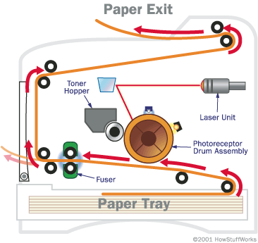
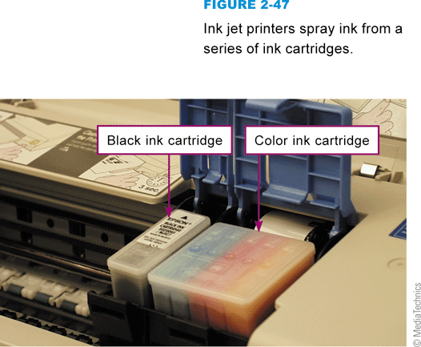
Printers
An ink-jet printer has a nozzle-like print head that sprays ink onto paper
A laser printer uses the same technology as a photocopier (path of paper through a laser printer in image on right)
Notes:
Figure 2-47

Slide 23
Printers
Color printers use CMYK = cyan, magenta, yellow, black (K)
Laser printers are faster than ink jet printers, usually more expensive
Printer resolution measured in DPI, dots per inch
Printer speed measure in PPM, pages per minute
Printers have RAM to act as a buffer, to hold a document until the printer can print it
Consider what you will do with the ink cartridges or toner cartridges. If possible, you should refill or recycle them.

Slide 24
Audio output devices
Speakers
Music, sound, speech
Easy for the computer to turn numbers into sounds
Most computers these days have built-in speakers
You can buy separate systems for better quality
Please use headphones or earbuds to listen if you are in a crowded environment

Slide 25
Protecting your computer
Power surges and brown outs can harm your computer parts
Lightning strikes nearby cause surge in the power lines
Protect your computer with
Uninterruptible Power Supply (UPS) – more expensive, usually also has battery backup to allow you time to shut the computer down correctly when the power fails. Usually provides better protection, faster fuses. Most have a place to plug in your telephone line also. Phone lines can carry surges too!
Surge suppressor – usually in the form of a power strip with a fuse. They are cheap, not always fast enough to protect your computer.

Slide 26
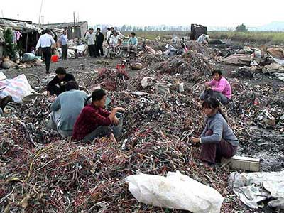
E-waste (Computers and Society)
Recycling electronics is good BUT…
Make sure you know where the waste goes
Many developing countries accept the waste and do not know how to handle/treat it
Ewaste is toxic if not handled correctly
Who is responsible for recycling the device?
The consumer?
The manufacturer?
The government?

Slide 27
Rare Earth Metals in electronics
Elements like yttrium and praseodymium (17 of them)
used in many different kinds of electronics: smart phones, speakers, radar systems, missiles, wind turbines, electric cars
mined from the earth but with difficulty – usually mixed with much other material – processing causes huge amounts of toxic waste
US consumes 20,000 tons, Europe 7000 tons, Japan 24,000 tons, China 104,000 tons / yr
China produces 80% of the market, recently cut off supplies to Japan over territorial dispute
Some other deposits – Russia, India, Australia, US
http://foreignpolicy.com/2016/07/12/decoder-rare-earth-market-tech-defense-clean-energy-china-trade/

Slide 28
Hardware Trends
Server farms / data centers
As demands for the internet and the Cloud increase, big companies build huge buildings full of servers. Take lots of power, cooling
Multi-core chips
Have the circuitry for two or more CPUs on the same chip
Quad core = 4 CPU’s
8 and 16-core chips coming onto the market
Independent processors for specialized tasks
Some printers have processors to speed up processing documents
GPU = graphics processing unit, specially for drawing graphics quickly

Slide 29
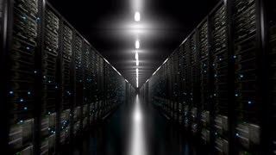
Hardware Trends
“Dark Data” center (see Wikipedia)
a facility that is almost exclusively administered remotely, so there is no reason to have lights on in the rooms – hence “dark data”
Are continuously monitored not just for data issues but temperature and humidity
Common tasks that would normally need a person to be there physically can be automated
Benefits include energy and staffing savings
Can be located in a remote area which can also lower costs and increase security

