Slide 1
Graphics - setCoords

Slide 2
The coordinate system of Zelle graphics
The default coordinate system for GraphWin is that the origin is in the upper left hand corner of the window
Y coordinates increase as they go down the window, X coordinates increase as they go to the right in the window
This is actually caused by history – the first display devices (CRTs) used electron beams to turn on pixels on the physical display screen, and the beams scanned starting in the upper left corner of the screen, working its way across the screen, then back to the left edge of the screen and down one row, etc. until lower right hand corner was reached, then the whole thing started over again

Slide 3
setCoords
There is a method for GraphWin objects which will let you change the origin to any place on the window that you wish
Some people find this easier to deal with than the default
The same method also allows you to scale the coordinates of the window (to be more compatible with the rest of your program)
You call the method as “win.setCoords(llx, lly, urx, ury)”
Where llx and lly are lower left x and y, urx and ury are upper right x and y

Slide 4
setCoords (0, 0, 10, 20)
Would mean that the lower left corner of the window is considered to be zero, zero (x and y are both zero)
And the upper left corner of the window would be considered (10, 20)
Note that the default size of a graphics window is 200 x 200. After setCoords, the x distance is divided into 10 units and the y distance into 20 units. This makes it possible to use floating point numbers as coordinates, like (5.5, 8.2)
Sketch on next slide

Slide 5
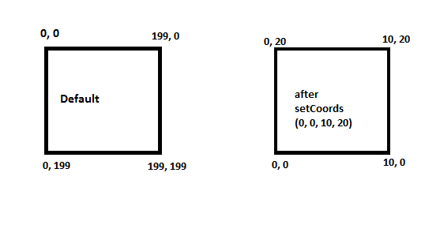
setCoords(0, 0, 10, 20)

