Slide 1
Decisions in Python
elif

Slide 2
A new keyword elif
A contraction of “else if”
Used to tie two if statements (or more) together into one structure
Syntax – elif, followed by a bool expression, ended with colon
elif will always be part of an if statement – cannot stand on its own
if a > b:
print(‘a’)
elif a > b+c:
print(“c”)
else:
print(“b”)

Slide 3
Semantics of elif
When you have an if structure that contains an elif
Evaluate the first Boolean expression, Test1
If Test1 comes out True, do the statements after the if and skip the rest of the structure
If Test1 comes out False, go to the elif and do the Boolean expression there (Test2). If Test2 is True, do the statements after the elif line, then skip the rest of the structure. If Test2 is False, go to the next elif or else statement and do the Boolean expression there.
If all the tests are False, eventually all the tests in the structure will be done. If the structure ends with a plain “else”, the statements after the else will be executed. If it ends with an elif, the statements are skipped.
Execution always picks up on the next statement after the if structure

Slide 4
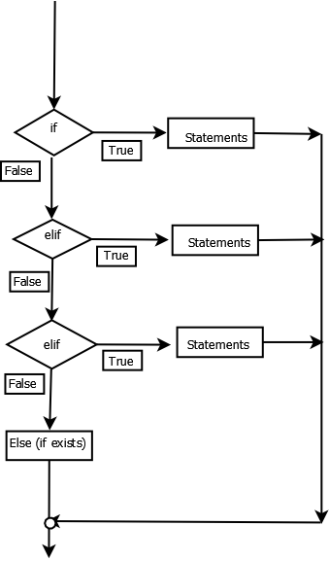
Semantics of elif

Slide 5
A chain of decisions
Sometimes you have a series of possible values for a variable
You could write the tests as separate if statements
  if x == “A”:
    print(“do A stuff”)
  if x == “C”:
  print(“do C stuff”)
  if x == “K”:
  print(“do K stuff”)
But this is pretty inefficient. Every test has to be done every time, regardless of which value is in x. And people make the mistake of putting an else on only the LAST if, to “catch everything else”. It does not do that. That else goes only with the last if, not with all the if’s.

Slide 6
Chaining if’s together
You can combine several if statements into one statement using elif
if x == “A”:
print(“do A stuff”)
elif x == “C”:
print(“do C stuff”)
elif x == “K”:
print(“do K stuff”)
This is more efficient because the tests are executed only until one is found to be True. That branch’s statements are done and then the entire structure is exited. No more tests are done.
This is also more flexible. If you choose to put a last “else:” at the end, to “catch everything else”, it does exactly that.

Slide 7
Caution – too many conditions
People tend to put in conditions which are not required
if x > 50:
print(“big”)
elif x <= 50: # this test is NOT required
# if this elif is executed, you KNOW x must be less than
# or equal to 50, you do not have to test for it
# A reason it is not good code: what if you make a mistake
# on second condition and leave out a branch?
Example: elif x < 50: # what happened to x == 50?
Summary: If your situation only has two mutually exclusive cases, use a plain if/else, not an if/elif.

Slide 8
If you don’t use elif
You do not HAVE to use elif. It is possible to write the structure as nested if statements, but the indentations required will cause the code to be clumsy to read. elif is aligned directly under the original if
Example: these two pieces of code are equivalent
if x > 5: print(“big”) else: if x > 0: print(“medium”) else: print(“small”) | if x > 5: print(“big”) elif x > 0: print(“medium”) else: print(“small”)

