Slide 1
Graphics - Aliasing

Slide 2
A problem with objects
In any object-oriented language, you can run into a problem while using objects
You need two objects made from the same class, and for some reason you don’t call the constructor function twice, you call it one time and then assign the object to another name
C1 = Circle (Point(10, 10), 25)
C2 = C1 # instead of calling Circle again
This creates a situation where ONE object has TWO names
This allows you to change the object using either name!

Slide 3
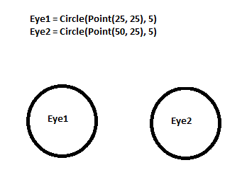
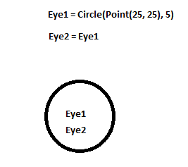
Aliasing
Do you see why they call it “aliasing”? The object has one name, but then is given an ‘alias’ = another name that it is known by

Slide 4
What’s the fix?
For graphics, one simple fix = don’t do it! Call the constructor when you need a new object
Another way to fix it is using the clone method. It will make another copy of the object it is called with.
C2 = C1.clone()
Will in fact have two circles after the statement
Problem also occurs with other compound structures (objects) in Python and most modern languages – we will mention it in regard to lists later

