Slide 1
Startup – Chapter 1

Slide 2
Computer Science is about solving problems
Problems in all kinds of domains
Science
Engineering
Business
Education
Entertainment
Steps in solving problems
State the problem clearly
Come up with a solution = an algorithm
Implement the algorithm

Slide 3
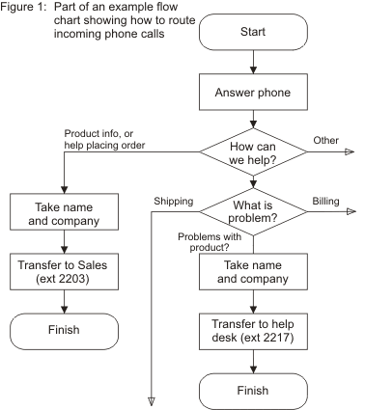
Algorithms
Step by step instructions on how to solve a problem
Sometimes described with flowcharts
More often with pseudocode
Calculate the sum of 10 numbers
1. initialize sum to zero
2. repeat 10 times
Read input from keyboard
Add input number to sum
3. report sum

Slide 4
Hardware terms everyone should know
RAM = random access memory
Volatile
Fast! (nanoseconds)
Expensive!
Secondary storage devices = hard drives, DVDs, flash memory
Not volatile
Slower (milliseconds)
Cheaper
(Separate video about computer units)

Slide 5
History of Computers
First computers were just calculators
They were not made to be faster than humans but more accurate
Human enters data into the “store” = RAM
Flips switches or moves cables around to indicate instruction “ADD”
Pushes go button, computer Adds
John von Neumann (Hungarian, mathematician, physicist)
Idea of putting instructions into the store as well as data
Computer could get instruction at mechanical speeds, not wait on human
Made computers general-purpose – change instructions in memory, change behavior of program
So YOUR program has to be loaded into RAM before it can be translated and executed too!

Slide 6
History continued
Alan Turing – British, mathematics, logician, codebreaker, computers
Came up with many basic ideas about computers in the 40’s
“Turing machine” – the simplest model of what a computer can do
“Enigma” – broke German codes during WWII
“Turing test” – start of Artificial Intelligence – how do we know when/if a computer is intelligent?
Why mention him? CodeLab is built by a company called Turingscraft

Slide 7
High level versus low level languages
First language = machine code = binary = 1101010101
Hard for humans to use
High level languages are written in words and in abstract ideas
x = y * 5 – z
Much closer to the way humans think
Require a translator to take it to machine code so computer (CPU) can run it
Different types of translators – compilers and interpreters
HLL are portable – they can run on many different kinds of CPUs

Slide 8
IDE = Integrated Development Environment
A set of tools that programmers use to make (develop) programs in a nice GUI (graphical user interface) (IDLE, WingIDE, Visual Studio)
Editor (lets you enter the source code)
Translator (compiler or interpreter)
Shell / command line window – for output and simple commands
Debugger (helps you find program bugs)
Linker (combines your object code with library code to make whole program)
Loader (brings in finished executable code to memory so it can run)

Slide 9
Python’s history
Created by Guido van Rossum – Dutch, worked for Google, works for Dropbox now
Means he wrote the first interpreter for Python
Made it open-source – anyone can see how Python works internally
Named after Monty Python’s Flying Circus
Python has a strange history of versions – there is now a version 2 and a version 3 (we use version 3!)

Slide 10
Ethics
Right now you know more about computers than 90% of the people on earth. By the end of class, you will know more than 95% of the people
Be careful how you use your knowledge
You should realize that programming is hard work! And programmers should be compensated for their work.
Everyone has private data. Sometimes it’s easy to access other people’s data because they are not aware of security issues. You can educate people!
If you are coding for someone (customer, company, etc.) be honest about the abilities of your program – and the bugs.

