Slide 1
CS 115 Introduction
Fundamentals of computer science, computers and programming
Taken from notes by Dr. Neil Moore

Slide 2
What is programming?
CS 115 is titled “Introduction to Programming”. What is that?
Telling a computer what to do?
But every time I click on a button or press a key, I am telling the computer what to do.
That’s not quite what we mean by programming.
We mean writing computer programs.
Back up a second – what is a “program” outside of computing?
a TV show is called a program
a concert has a program – what is going to happen when, in what order
A program is a sequence of instructions telling a computer how to do something.
You plan out the steps in advance for how to solve a kind of problem
Then we have the computer execute (follow) the steps – the program.

Slide 3
What is computer science?
So what is computer science, and how does it differ from programming?
the “study of computers”?
“Computer science is no more about computers than astronomy is about telescopes.” – attributed to Edsgar Dijkstra
Astronomers DO study telescopes but that is not ALL that they study, and they study them because they are tools to help them learn more about the universe.
Questions about computation came up long before computers.
It used to be people following the step-by-step instructions.
They used tools like an abacus, a slide rule, pencil and paper, …
What did we call those people?
“Computers” !
When you do long division or sort a list of items, you are computing.

Slide 4
Computers!
A very early “computer network”☺ around 1890.
This is from Wikipedia.org, “Harvard computers”, E.C. Pickering’s astronomy lab at Harvard.

Slide 5
What is computer science?
Computer science is the study of:
What can be computed using step-by-step procedures, “algorithms”.
“decidability”, “halting problem”, “complexity”
How best to specify these procedures
Notations and Programming languages
How to tell if a procedure is correct, efficient, optimal, etc.
verification of programs, debugging, testing, analysis of algorithms
How to design procedures to solve real-world problems.
Software engineering, structured programming paradigm, object-oriented design

Slide 6
Algorithms = Designs
“Step-by-step procedure” is called: an algorithm or a design.
These are the steps to solve a problem.
Recipes, how to assemble a kit, GPS directions, long division
Steps can be described in English or other natural languages, or flowcharts or maps or drawings or programming languages
In programming, a design is written in pseudocode.
ordered (sometimes numbered) steps in English
not the same as coding; instead, an abstract view of what needs to be done
Figure out what you’re going to do before you start doing it!
We’ll start with a non-computer example.

Slide 7
Design: building a dog house

Slide 8
Design: building a dog house
Let’s say we want to build a dog house. What steps do we need to take?
Decide on a location and a size for the doghouse.
Get materials for the house.
Cut a piece for the floor.
Cut shapes for the four walls.
Cut a door into one wall.
Attach walls to the floor.
Make roof.
Attach roof to walls.
Paint the outside.

Slide 9
Notes on the Design
Steps are numbered in the order they should be performed.
If I try cutting the door after attaching the walls to the floor, it will be difficult.
We ask you to number your steps for the first few designs in this class.
Some steps could be further divided:
“Get materials”: what materials? Where? Do we need a budget?
“Make roof”: cut some wood at an angle, nail together, add shingles
“Cut shapes for four walls”: a step that is repeated 4 times
Could go into more detail: how big is a wall? The door? What units?
Designs can go through several versions, each more ‘refined’ than the last

Slide 10
Design for dog house, refined
Decide on a location and size for the doghouse.
Get materials for the house.
Get lumber.
Get paint.
Get nails.
Cut a piece of wood for the floor.
Repeat four times:
Cut a piece of wood for a wall.
Cut a door into one wall.
Attach walls to the floor.
Make roof.
Cut two pieces of wood.
Join the pieces at a 90 degree angle.
Nail the pieces together.
Attach roof to walls.
Paint the outside of the walls.

Slide 11
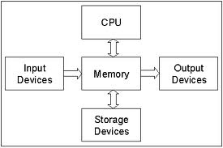
Basic Hardware
Hardware vs. Software
Hardware includes
CPU = central processing unit
Memory = RAM (random access memory)
Input = Keyboard, mouse, microphone
Output = Screen, speaker, printer
Storage = Hard drive, DVD, Solid State devices
Volatile vs. non-volatile
Memory and the CPU are volatile – they lose their contents when the power cuts off
Storage is NON-volatile – they maintain their contents until you erase them

Slide 12
Parts of a computer
RAM: the computer’s “working memory”
“Random Access Memory”
Made up of circuits (each one a word) that each hold one number
Numbers are represented in binary
Volatile: information is lost when the power goes off.
Fast devices to access (retrieve or write to), in nanoseconds
Relatively expensive part of the computer
Von Neumann architecture: CPU reads instructions and data from RAM.
Secondary storage: hard drives, flash drives, DVDs, …
Persistent: data can be stored for hours, days, years or decades
Slow (microseconds or milliseconds: less than 1/1000th the speed of RAM)
Relatively cheap part of the computer
Data and instructions must be transferred from secondary storage to RAM before the CPU can use them (Von Neumann architecture again)

Slide 13
Parts of a modern computer
CPU: Central Processing Unit.
Reads instructions from RAM
Executes (carries them out) in order
Instructions are simple: add numbers, is-equal, skip to another instruction
Works with speeds as fast as RAM (nanoseconds)
Relatively expensive component of a computer
Peripherals
Input devices bring data in to RAM from the outside world
Output devices take data out from RAM to the outside world

Slide 14
Computer numbers
RAM consists of circuits that each can store a single binary digit = 1 bit, usually written as 0 or 1
Computers use binary numbers: the place values are powers of two
Place values: 1, 2, 4, 8 , 16, 32, 64, 128, 256, 512, 1024, 2048, …
Bits are combined into bytes, in modern usage 8 bits for each byte.
One byte can represent a number from 0 to 255
Or a single character in ASCII code.

Slide 15
Computer capacity or speed units
It’s pretty inconvenient to throw around very large numbers when talking about the capacity of a hard drive or SD card or the speed of a download (numbers of bytes), so larger units were created
Kilobyte (kB): 2¹⁰ = 1024 bytes (roughly a page of text)
Megabyte (MB): 2²⁰ = 1024 kB or 1024 * 1024 bytes, which is approximately one million bytes (like a 1000-page book)
A song in MP3 format might take 3 or 4 MB.
Gigabyte (GB): 2³⁰ = 1024 MB = 1024 * 1024 * 1024 bytes, which is approximately 1 billion bytes (like 1000 of those books, a library!)
A DVD is about 4.7 GB in capacity, a Blu-Ray might be 17 GB.
A modern personal computer might have 16 GB of RAM.
Terabyte (TB): 2⁴⁰ = 1024 * 1024 * 1024 * 1024 bytes (1024 GB, a large library)
A modern hard drive might contain 1 to 2 TB of storage.

Slide 16
Programming languages
Computer programming is the process of translating an algorithm into instructions that a computer can understand.
A programming language is a formal constructed language designed to communicate instructions to a computer.
There are thousands of programming languages in existence, dozens or hundreds of which are still in regular use.
A professional programmer usually knows several. They can choose the right tool (language) for each job.
In CS 115 we’ll learn to write programs in Python, a high-level interpreted programming language. Python was created by Guido van Rossum.
Notes:
https://en.wikipedia.org/wiki/List_of_programming_languages

Slide 17
Guido van Rossum, creator of Python
Born in the Netherlands
Began to develop Python in 1989
Has worked for Google, DARPA, Dropbox, retired at present (picture from Wikipedia, 2014)
Named Python after Monty Python’s Flying Circus
Released Python 1.0 in 1994
Latest version of Python is 3.9
Python is used for things like websites, scripts, games, graphic interfaces. It is used by Pinterest, Instagram, Yahoo, Google, Dropbox, Netflix, etc.

Slide 18
Programming languages have syntax and semantics
In a given programming language:
Syntax are the rules that say what programs look like, how the statements in the language are formed
Spelling of keywords
Punctuation
Order and combination of words (grammar)
Semantics are the rules that say what the programs mean:
What does the computer do when it executes this statement?
When you combine these statements, what happens inside the computer?
Notes:
Contrast to English
when did YOU learn English syntax? Spelling? Punctuation? Diagramming sentences? Subject-verb-object?
When did you learn English semantics? A little at a time and you are still learning – a dictionary is useful for this
Mention e.e.cummings?

Slide 19
Interpreters and Compilers
In All cases, the computer still only understands machine code. So if we write in a high-level language, we have to have it translated into machine code.
Generally there are two ways to do this: an interpreter or a compiler.
Interpreter: translates the statements and executes the statements in order
+plus: Easy to change your program – you edit it, then run it again.
-minus: The statements must be translated each time: this makes it slow.
-minus: Users of the program must have a copy of the interpreter for themselves.
Examples of interpreted languages: Python, JavaScript, Perl.

Slide 20
Compilers
Compiler: translates statements in a language into machine code.
Without executing it!
-minus: Changing a program requires another step – after editing it, you have to compile before you run.
+plus: Compile once, execute many times, no repeated translation needed, so it runs faster
+plus: The machine code is run directly by the Operating System. You do not need to have the compiler on the machine at all.
Examples: C++, FORTRAN, Haskell.
Some languages combine features of both: Java is compiled into an intermediate byte code and then interpreted.

Slide 21
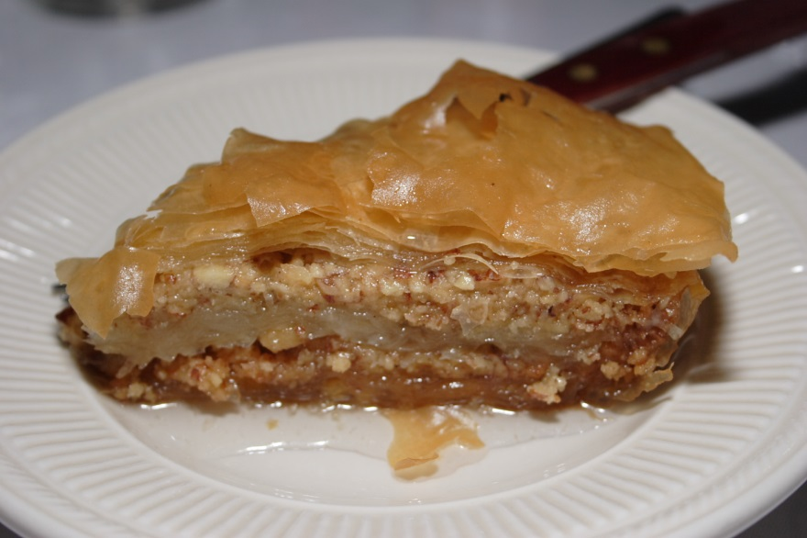
A Baking Analogy
Suppose you wanted to make baklava (a kind of Greek dessert pastry). You have a recipe on paper but it’s in Greek and you don’t know the language.
You have a friend who speaks Greek and English but doesn’t know how to bake.

Slide 22
A Baking Analogy
What do you do?
Two options:
Have your friend stand with you in the kitchen, reading the recipe (in Greek) and telling you the instructions one at a time in English. Your friend is acting as an interpreter.
Give your friend the recipe and ask them to translate it from Greek into English and write it down. Your friend is acting as a compiler.
You can get started quicker with the interpreter, but you will need your friend in the kitchen every single time. It takes a bit more time at the beginning for the compiler, but once your friend has done their job, you don’t need them any more – you have the recipe written in English.

Slide 23
Programming environment and tools
What do you need to write programs in Python?
An interpreter to translate and execute your program
A text editor for writing and changing your source code
Notepad is possibly useful but not really suited to programming
More advanced editors can:
Automatically indent the code
Color code to clarify its meaning
Jump from variable name to its definition
Jump from function call to its definition
Much more…

Slide 24
Programming environment and tools
A debugger to help find and repair bugs
Pauses execution at a given line
Steps through code line by line.
Inspects the values of variables
Shows the sequence of function calls being done
These are just some of the tools used by professional programmers.
When programming was a new activity, programmers used the command line a lot – each tool was run by a command, in a certain order: first edit, then compile, then run, then edit, then compile…
When Graphical User Interfaces (GUIs) became available, programmers started using them to “hold all their tools together”.

Slide 25
Integrated development environments
An IDE (integrated development environment) combines several programming tools together into one cohesive program.
Some IDEs for Python:
IDLE comes with Python – it’s installed when Python is.
WingIDE is recommended for this class – it’s free, more professional looking and less likely to crash.
PyScript, PyCharm, Spyder are a couple other IDEs that you can find for free.
Demonstrations will use WingIDE.
Debugging and other topics in a few weeks.

Slide 26
How to do a design in CS 115
Use a plain text editor, not a word processor
The editor in IDLE or WingIDE works fine
Notepad works fine
Mac TextEdit: go to the Format menu, choose “Make Plain Text”
otherwise it saves as RTF (rich text format) NOT plain text!
State the purpose of the program at the top
follow by your name, section, email
Write one step per line
Start each step with a “#” symbol – this is not for the interpreter to use
If you break one step down into parts, indent them under the main step and number them accordingly, like step 7 is broken into 7.1, 7.2, 7.3, …

Slide 27
How to do a Design in CS 115
Hint: wait until you are satisfied with your design to number the steps.
Why? that way you don’t have to renumber if you add or delete steps
Give your file a name ending with .py as an extension (Python code)
Why? the design will be the skeleton for your implementation (the outline) when you start writing Python code.
This way it’s easy to make a copy of your design and start filling in Python code after each step. The design step tells you what needs to be done.
Wing IDE will automatically put .py on your filename by default, with IDLE you have to type it yourself.

Slide 28
Example program design
# Purpose: Ask for the user’s name and greet them.
# Author: J. Random Hacker, section 1,
# random.hacker@uky.edu
# Main Program:
# 1. Input the user’s name from the keyboard
# 2. Ask for their age
# 3. Tell them how old they will be in 10 years.

Slide 29
Design turned into code
# Purpose: Ask for the user’s name and greet them.
# Author: J. Random Hacker, section 1, random.hacker@uky.edu
# Main Program:
def main():
# 1. Input the user’s name from the keyboard
name = input(“What’s your name? “)
# 2. Ask for their age
age = int(input(“How old are you (in years)? “))
# 3. Tell them how old they will be in 10 years.
print(“In 10 years you will be”, age+10, “years old”)
main()

