Slide 1
CS 115 Lecture
Conditionals and if statements
Taken from notes by Dr. Neil Moore

Slide 2
Selection
Sometimes we want to execute code only sometimes.
  “Run this code in a certain situation.”
    How do you express “in a certain situation” in code?
  “Run this code if this expression is true.”
    So we’ll need expressions that can be True or False
    We mentioned a type that has 2 values, True or False, the second week of class
    bool (Booleans)

Slide 3
The boolean type
The type bool in Python represents a value that is either true or false.
  Two literals (constants): True and False
    Case-sensitive as always!
  You can have boolean variables:
    is_finished = False
    Sometimes they are called flags (more when we get to loops)
  … and boolean expressions:
  is_smallest = number < minimum
  can_run = have_file and is_valid

Slide 4
Naming boolean variables
This isn’t a hard-and-fast rule but try to name boolean variables as a sentence or sentence fragment:
  Is this item selected? is_selected
  Is the user a new user? user_is_new (or is_user_new)
  Does the program have an input file? have_input_file
  Does the user want the answer in meters? want_meters
Why is_selected and not just selected?
  Ambiguous: it could also mean “which item is selected?”

Slide 5
Equality
Other than literal True and False, the simplest boolean expressions compare the values of two expressions.
Less than, greater than, …
Even simpler: “is equal to” and “is not equal to”
  The equal sign is already taken for assignment
  So equality testing uses the symbol ==
  logged_in = password == “hunter1”
      No spaces between the ==
Contrast: “==“ compares values, the “is” operator asks “are they aliases?” (names for the same object)

Slide 6
Inequality
It’s kind of hard to type ≠ so Python uses != for the relationship “is not equal to”
  need_plural = quantity != 1
  did_fail = actual != expected
How does an assignment statement like this work? Like any other!
  Evaluate the right hand side (the != gives a True or False value)
  Store that True or False value in the variable on the left hand side

Slide 7
Comparisons
Besides equality and inequality, Python has four more comparison, relational, operators:
Less than and greater than:
score < 60
damage > hit_points
Less than or equal to, greater than or equal to
students <= seats
score > 60
The opposite of < is >=, that is,
a < b is False if a >= b is True

Slide 8
Comparisons
Precedence: all relational operators are lower than arithmetic operator, higher than the assignment operator
  need_alert = points + bonus < possible * 0.60
  is the same as
  need_alert = ((points + bonus) < (possible * 0.60))
They are all of equal precedence to each other, so having more than one in an expression works left to right

Slide 9
Relational operators and types
What type does the relational operators return? (that is, the result) ?
  bool
What types can be compared using relational operators?
  Numbers: ints and floats
  str – what does it mean to compare two strings?
    When computers were new, each hardware manufacturer had their own code of numbers to stand for alphabetic characters
    Users didn’t care as long as they press ‘A’ on keyboard and got ‘A’ on screen
    When people wanted to swap data between hardware brands, found out they needed a Standard Code for encoding characters
    Some competition, but ASCII won out! Being used by microcomputers didn’t hurt ASCII’s popularity either.
    ASCII is used more today than any other character code by FAR, 90% of the computers in the world use it

Slide 10
Comparing strings
  str – what does it mean to compare two strings?
    ASCII order – American Standard Code for Information Interchange, created in the 70’s, Unicode created later
    Each character is assigned a numeric value, those values are actually what’s compared
    Alphabetic characters are in alphabetic order
      ‘A’ < ‘B’ < ‘C’ < … < ‘X’ < ‘Y’ < ‘Z’ (upper case)
      ‘a’ < ‘b’ < ‘c’ < … < ‘x’ < ‘y’ < ‘z’ (lower case)
    Uppercase Z comes before lowercase a
      ‘A’ < … < ‘Z’ < … < ‘a’ < … < ‘z’
    Digits are in numeric order ‘0’ < ‘1’ < ‘2’ < … < ‘9’
    Digits come before alphabetic characters
    And “ “ (one space) comes before all other printable characters
    ‘ ‘ < ‘0’ < … < ‘9’ < … < ‘A’ < … < ‘Z’ < … < ‘a’ < … < ‘z’

Slide 11
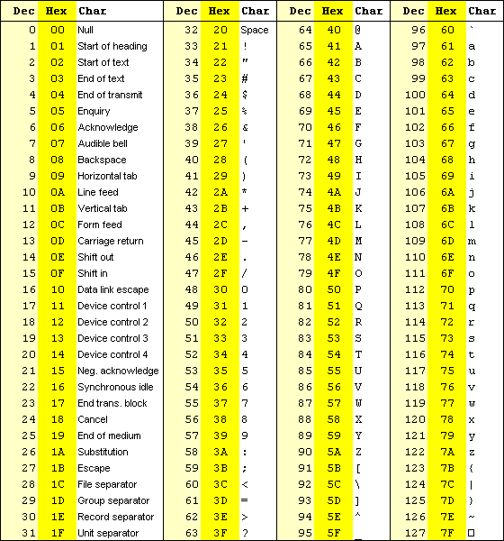
ASCII and Unicode
http://unicode-table.com/en/#control-character
ASCII table

Slide 12
A note about “characters”
Character vs. Letter
    A character is ANY symbol you can get from the keyboard (actually any element of the ASCII character code, or these days, of the Unicode character code)
    A Letter is specifically an upper or lower case letter of the alphabet - a total of 52 characters

Slide 13
A note about “characters”
Computer scientists use terms carefully
  Number vs. numeric string
    A number is a value that is stored in RAM where it can be accessed, in some pattern of bits. It has the data type of “integer” or “float” (in Python)
    A numeric string is a string of characters which has only digits, a “+” or a “-” at the front, possibly a decimal point “.”, possibly an “e”, in the right order. It is a string, not an int or a float
  Digits vs. Letters
    There is no overlap between these two sets of characters

Slide 14
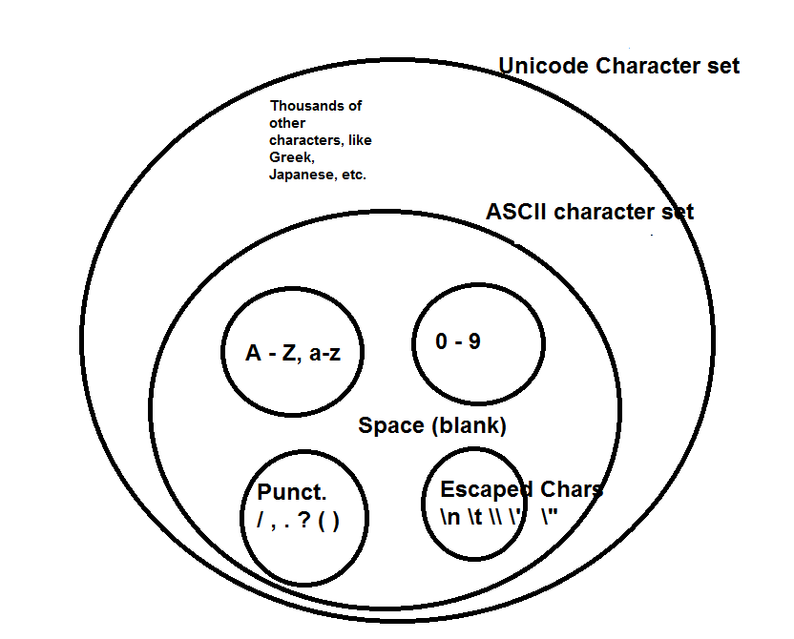
Relationship of groups of characters

Slide 15
Comparing strings
That’s fine for single character strings, but what if they are longer?
Algorithm says start from left end of each string
  Compare – are they the same or different?
  If they’re different, you can decide which is less
  If they are the same, move one character to the right in each string and repeat comparison
  You’ll either run out of string or find a difference
  If run out of both strings at same time, they’re equal
  If run out of one before the other, the shorter is less

Slide 16
Comparisons
Relational operators cannot mix strings and number values
  3 < “Hello”
    TypeError: unorderable types: int() < str()
It’s ok to mix ints and floats though
Be careful comparing floats to floats – they may NOT be equal though we think they are, especially if the float was generated by repeated arithmetic operators

Slide 17
The if statement
Now that we can write some boolean statements, how do we use those to control whether or not certain statements execute?
Use an if statement
Syntax
  if expression:
  body
The expression should evaluate to True or False
The body is an indented block of code
Semantics: Evaluate the expression
  Runs the body if the expression was True
  Goes on to the code line after the body, either way

Slide 18
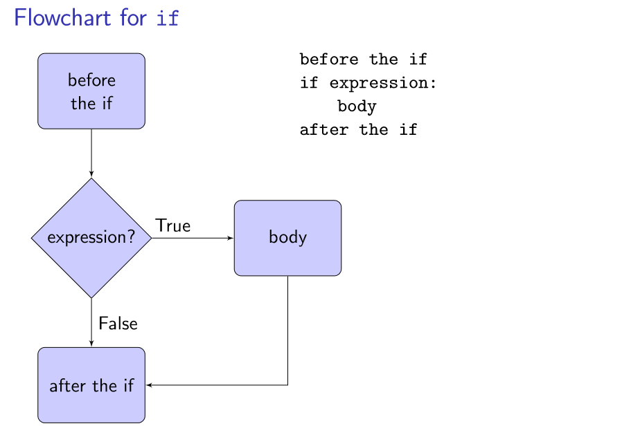
Flowchart for if

Slide 19
Alternatives: else
Commonly we want to do either this or that (but not both).
In Python we can use an else block. Syntax:
  if expression:
  if-body
  else:
  else-body
  Both bodies are indented blocks
  No expression on the line with else!
  Cannot have an else without an if first!

Slide 20
Alternatives: else
Semantics:
  Always evaluates the expression
  If the expression is True, runs the if-body
  If the expression is False, runs the else-body
  Either way, goes on to the code line after the else-body
Only use else if there is something to do in the False case
  It’s ok not to have an else!

Slide 21
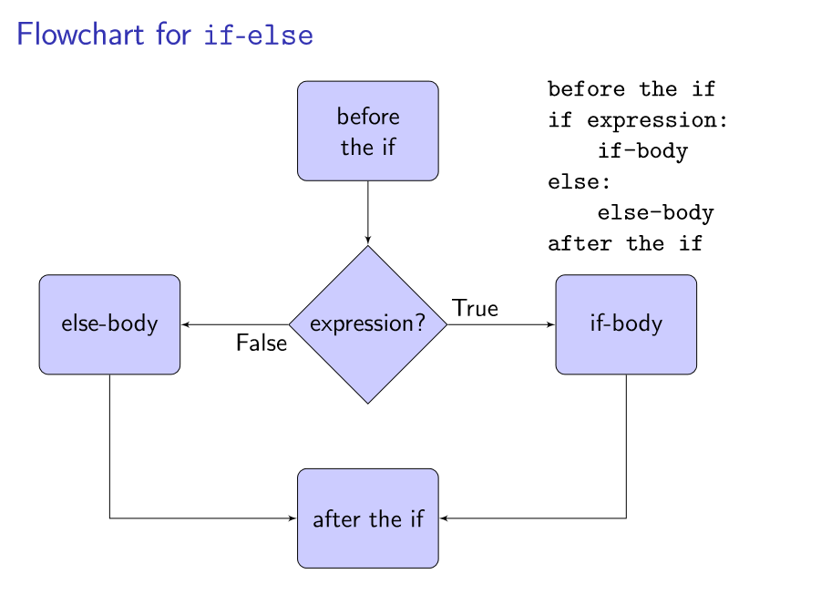
Flowchart for if-else

Slide 22
Indentation matters!
Example 1
Example 2
if a > 9:
if y < 5:
print(“yes”)
else:
print(“nope”)
(which path has NO output?)
if a > 9:
if y < 5:
print(“yes”)
else:
print(“nope”)
(which path has NO output?)

Slide 23
Many alternatives
Sometimes there are more than two alternatives
Converting a numeric score into a letter grade:
  If the score is greater than or equal to 90, print A
  Otherwise, if score is greater than or equal to 80, print B
  Otherwise, if score is greater than or equal to 70, print C
  And so on…
We want to run exactly one piece of that code
  even though 95 >= 70, we don’t want 95 to cause C to print too!
  First check if score is >= 90
  If that was False, check if score >= 80
  If that is False too, check if score >= 70, …
The order matters!
  What would happen if we swapped the order of the B and C grades?
  Then we’d never report a B!

Slide 24
Chained alternatives: elif
Syntax:
  if expression 1:
  body 1
  elif expression 2:
  body 2
  elif expression 3:
  body 3
  …
Each elif is followed by an expression and a colon
Each body is an indented block
You can have an else block at the very end. It is not required.

Slide 25
Chained alternatives: semantics
Semantics:
Evaluates expression 1
If expression 1 was True, run body 1 (and that’s ALL)
If expression 1 was False, evaluate expression 2
If expression 2 was True, run body 2 (and that’s ALL)
If expression 2 was False, evaluates expression 3
After running at most one body, goes on to the next line of code after the end of the chained if statement
Only runs one body, or none
It runs the body of the first True expression

Slide 26
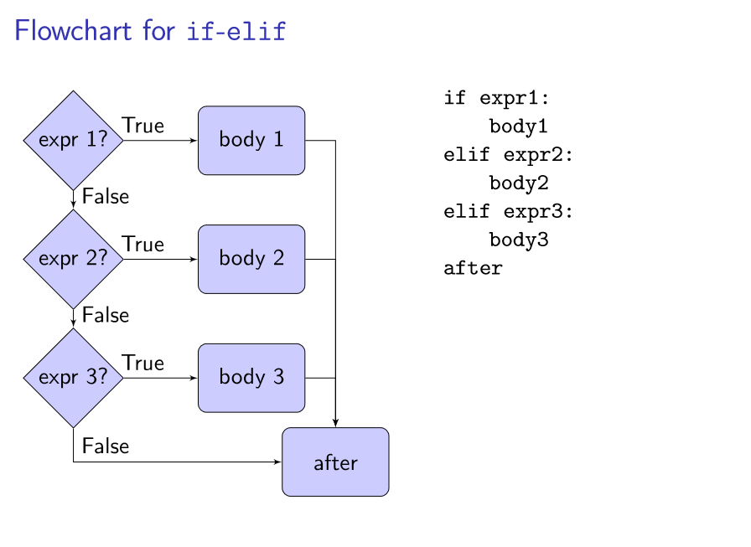
Flowchart for if / elif

Slide 27
Open and closed selection
If there is an else in a chained if/elif, the selection is called closed
  Meaning that exactly one of the bodies will run
Otherwise it is open: zero or more bodies will be run
If the last elif is supposed to cover all the remaining cases, you should prefer else instead:
  if score >= 90:
  grade = ‘A’
  elif score >= 80:
  grade = ‘B’
  elif score >= 70:
  grade = ‘C’
  elif score >= 60:
  grade = ‘D’
  else:
  grade = ‘E’

Slide 28
Thinking about ifs
How is the problem you are solving expressed?
  Are you looking for specific values, nothing else is of interest?
  Are you dividing a range up into specific segments, so that everything is of interest?
  Are you testing for conditions that are mutually exclusive? (if one is true, the rest cannot be)
  Or conditions that overlap? (that are independent of each other, if one is true, the others may or may not be)

Slide 29
Example for specific values
if x == 5:
  print(“do the 5 thing”)
  elif x == 19:
  print(“do the 19 thing”)
  elif x == -2:
  print(“do the -2 thing”)
  # nothing else to do here, if it’s not 5, 19 or -2 I don’t #care
  # there is NO else here!
  # does order matter here?

Slide 30
Dividing a range
if x > 100:
print(“wonderful!”)
elif x >= 70:
print(“ok”)
elif x >= 55:
print(“meh”)
else:
print(“bleah”)
# need the last else to catch #“everything lower”
#Note that order matters here!

Slide 31
Mutually exclusive conditions
if x % 10 == 5:
print(“that’s a number ending in 5”)
else:
print(“not a 5 on the end!”)
# you do NOT need “elif x % 10 != 5:”
# if the first test is false, the other must be true

Slide 32
Overlapping conditions
if x > 50:
print(“too high!”)
if x % 2 == 0:
print(“that’s even”)
# two separate, independent if’s, because the
# tests were independent of each other.
# if one is True, the other may or may not be #True
# does the order of the if’s matter?

Slide 33
Using elif
If you want more than one branch to execute, you don’t want elif. There you would use a sequence of separate if statements

Slide 34
“Factoring out” code
If you write an if with more than one branch, look carefully at the code in the branches. If the SAME statement appears in both the branches (for an if/else) or in ALL the branches for a multiway if/elif/else statement, see if you can “factor it out”.
Example:
  if z > b:
  print(z)
  z = b * 2
  else:
  print(z)
  z = 9 * b
The code that is common to both branches should be done OUTSIDE the if statement altogether. In this case, do it before the if statement.

Slide 35
“Factoring out” code
Why is this a big deal?
  Efficiency – why write code twice?
  Less code to debug
  More likely to get it right if it only appears in ONE place instead of 2 or 3!
Be careful! It may not always be possible. In this example, If the print in the else-block had come AFTER the assignment statement, then the prints would have been doing different things and should NOT be factored out

Slide 36
Testing if statements
When testing programs with if statements, be sure to consider and test all the possible outcomes.
If your tests never execute a particular line of code, you don’t know if it works!
For every if or if-else, you should have two cases:
  one where the test is True
  one where the test is False – even if there is no explicit else branch.
For a chained if/elif, you should test
  Expression 1 is True
  Expression 1 is False, expression 2 is True
  Expression 1 and 2 are False, expression 3 is True
  …
  All the expressions are False
  If you had a chain with N elif’s, you should have N+2 test cases

Slide 37
More testing
It helps to consider combinations of separate if statements too
  Especially when they use the same variables
  if userID != “admin”:
  is_valid = False
  if password != “password”:
  is_valid = False
You can get four test cases for these two if’s
  UserID right, password right
  UserID right, password wrong
  UserID wrong, password right
  UserID wrong, password wrong

Slide 38
More testing
Don’t forget to check the boundary cases
  what if the score is exactly 60.0?
  what if the score is 59.9?
  what if the score is 0?
  what if the score is 101?

